Slide 1
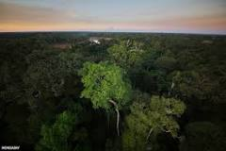
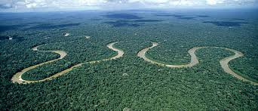
My Rainforest Research
By Odhran Montgomery

Slide 2
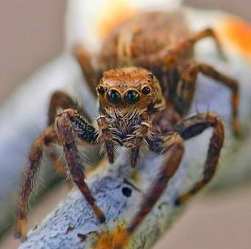
The Bird Eating Spider
Eats Mice, Frogs and Birds
Lives in holes underground
Is bigger than some birds
Has 500 to 1000 babies in one egg

Slide 3
The Bird Eating Spider
Lives in holes in the ground and uses vibrations to feel when its prey is close.
You can find the tarantula in the amazon rainforest.
The spider also eats mice, rats and frogs.
Their legs can be more than 12 inches long
Their hair can be dangerous to humans if they breathe them in

Slide 4
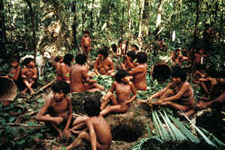
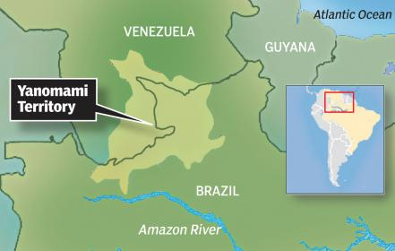
The Yanomami Tribe
There are approx 38,000 people in the tribe
They live in Northern Brazil and Southern Venezuela

Slide 5
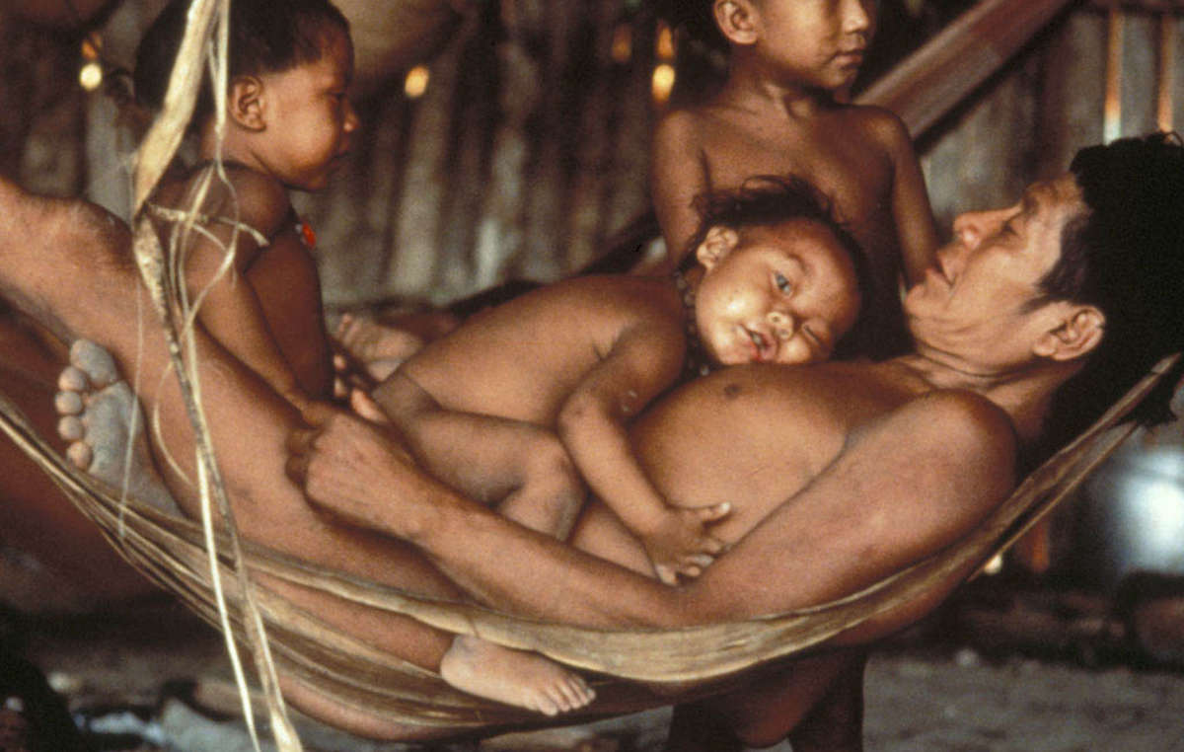
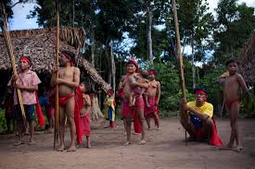
Their clothes
They usually do not wear clothes
When they do they wear small bits of cloth

Slide 6
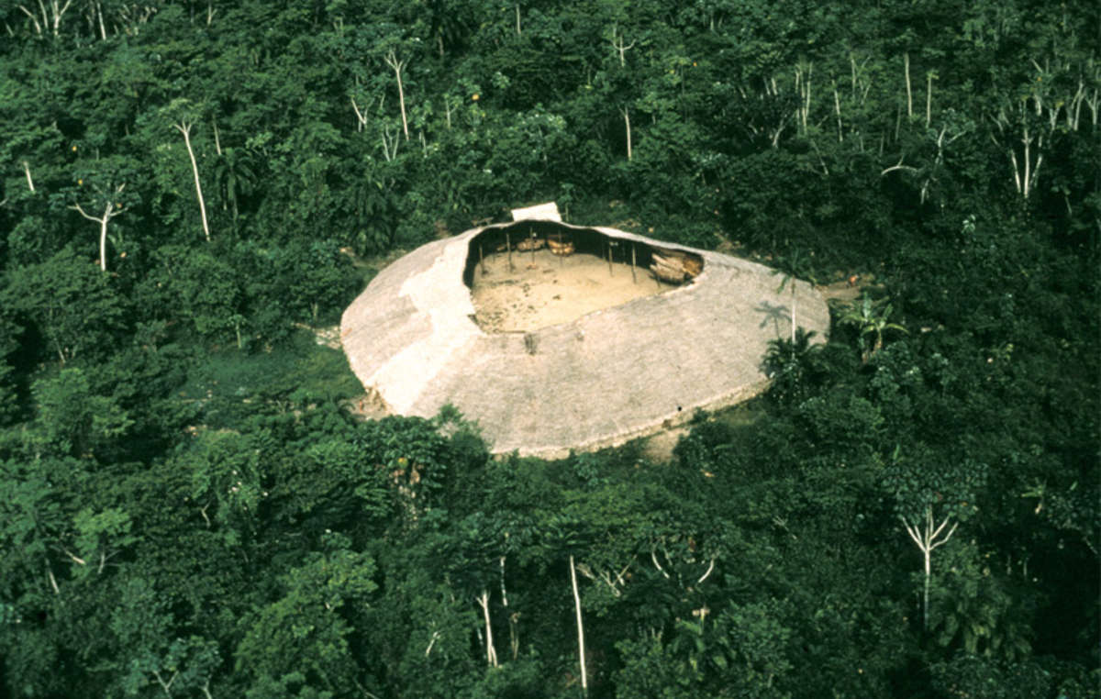
How they live
This can house over 400 people
This is called a Yano or Shabono

Slide 7
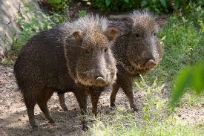
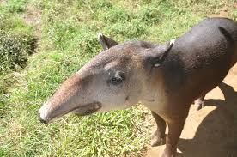
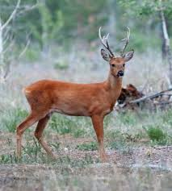
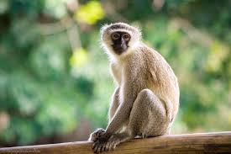
Men are the hunters and they hunt for meat
Peccary
Tapir
Deer
Monkey

Slide 8
Women gather up 80% of their food source and this includes
Wild Honey
Shellfish
Nuts
Insect Larvae

Slide 9
Threats they face
Illegal gold miners killing people and digging their homes up
Outsiders bringing in diseases they cannot fight
No medicines or doctors
Mining by the government
Deforestation by cattle ranchers wanting their land

